Slide 1
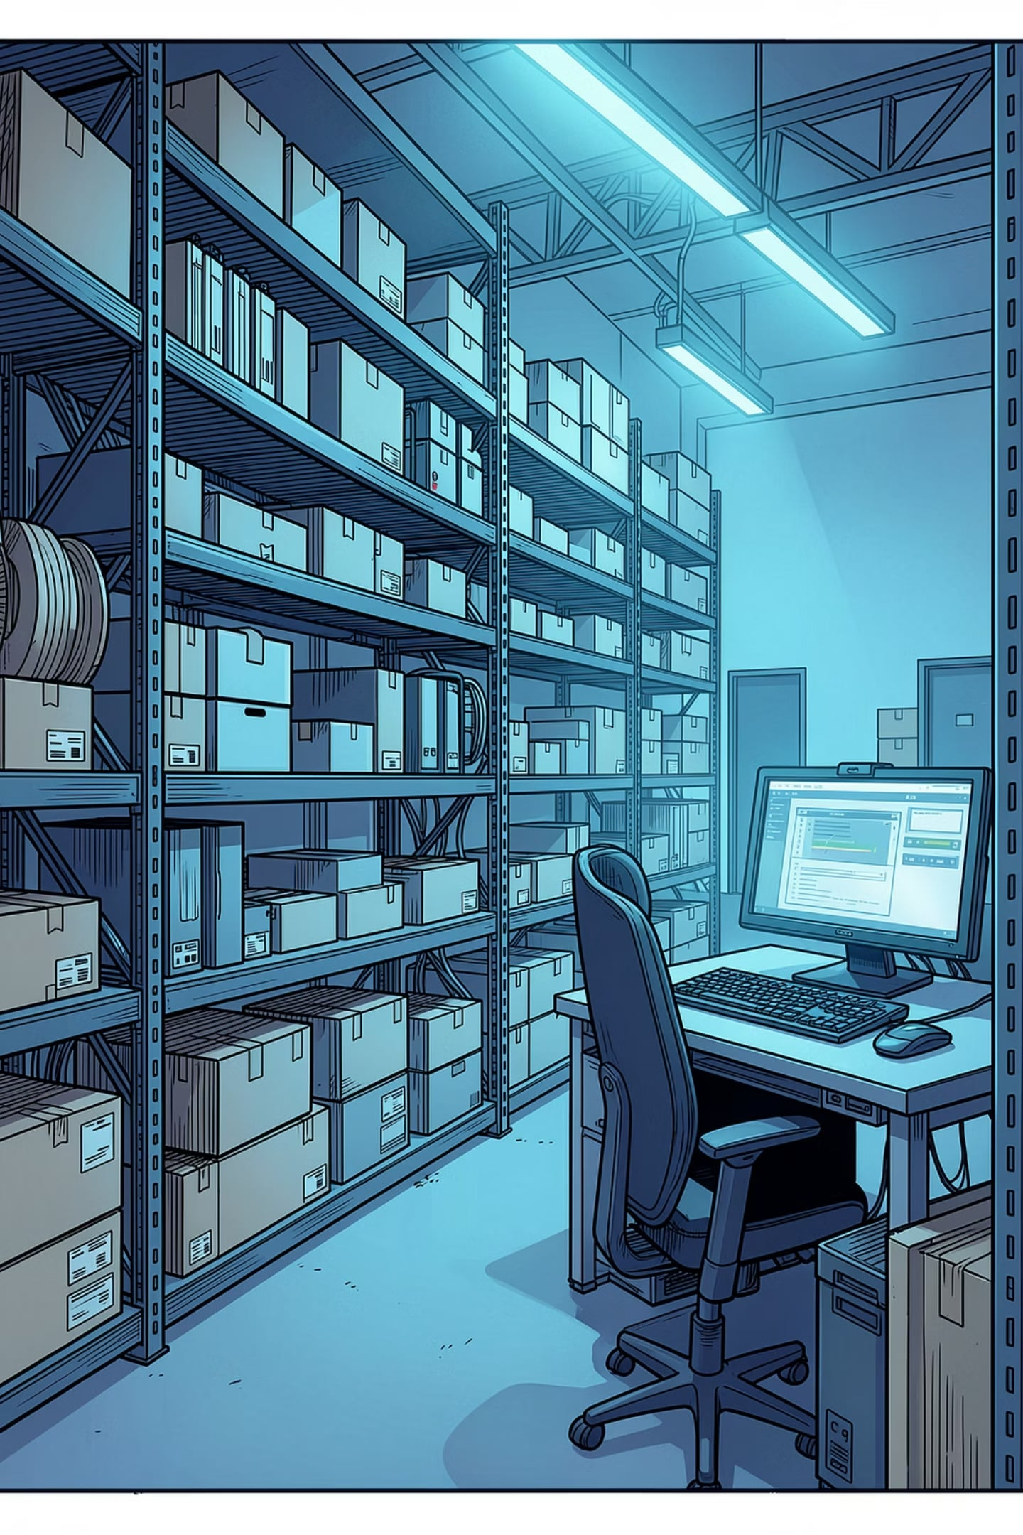
Inventory Management System
C Programming Project — B.Tech First Year
Jitesh, Khush, Khushi, Kiran, Keerty, Koshal, Krishna, Kshitiz, Latika, Mahi ·
Department of Computer Science
B K Birla Institute of Engineering & Technology, Pilani

Slide 2

PROJECT OBJECTIVE
What Are We Building?
Develop a menu-driven C application that maintains stock information efficiently — enabling users to add, search, update, delete, and report on products, with all data stored permanently in files.
Efficient
Persistent
Fast, organised product management
Data saved permanently to files
Interactive
Menu-driven, user-friendly interface

Slide 3
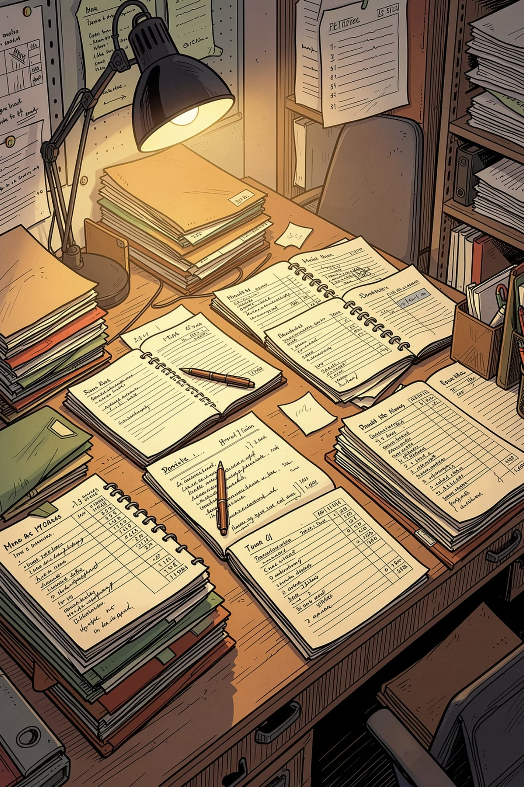

PROBLEM STATEMENT
Why Manual Inventory Fails
Difficult to Manage
Tracking hundreds of products manually is error-prone and unsustainable
Time-Consuming Search
Finding a specific product record takes significant manual effort
Human Errors
Miscalculations in stock counts lead to costly discrepancies
Poor Stock Tracking
No real-time visibility into current inventory levels

Slide 4





CORE FEATURES
What the System Can Do
Add Product
Update Quantity
Search Product
Register new items with ID, name, price, and quantity
Modify stock levels for existing products
Locate any product instantly by ID
Delete Product
Stock Report
Remove discontinued items from the inventory
Display a complete summary of all products

Slide 5
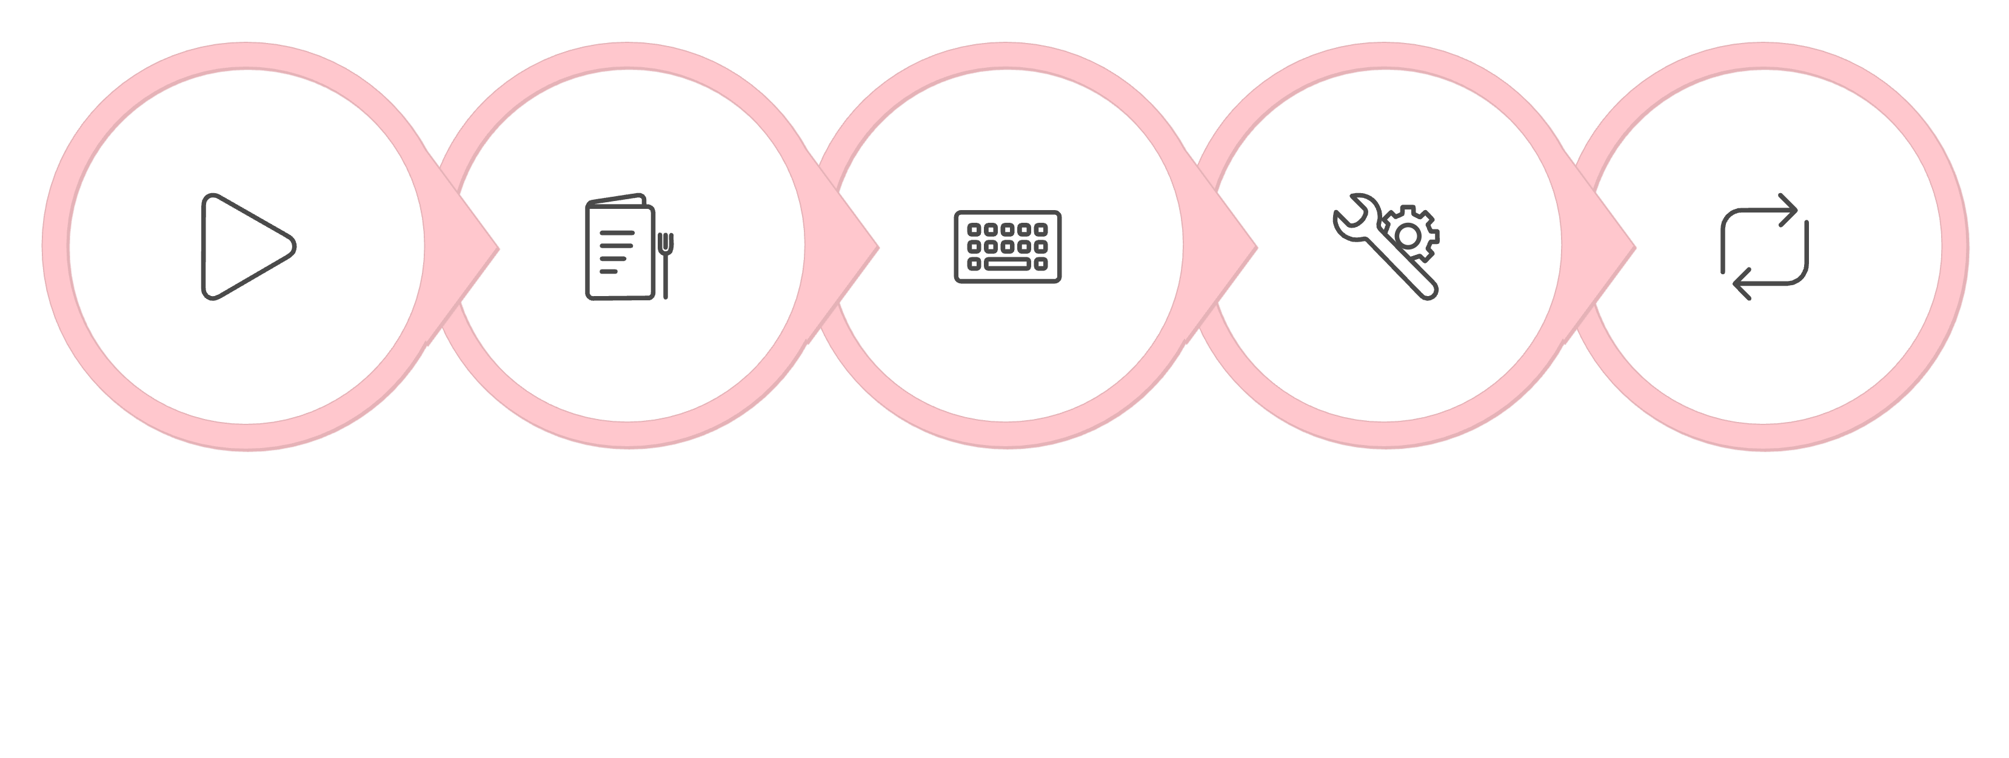

PROGRAM LOGIC
Main Algorithm
Execute Operation
Repeat Until Exit
Start
Display Menu
Read Choice
The program runs in a continuous loop, presenting the menu after each operation until the user selects Exit.
Add Product
Search Product
Update Quantity
Input ID, Name, Price, Quantity → Store in file → Display success
Enter Product ID → Search file → Display details or "Not Found"
Enter Product ID → Search → Enter new quantity → Update file
Delete Product
Stock Report
Enter Product ID → Search → Delete record → Save remaining records
Read all records → Display all products with details

Slide 6
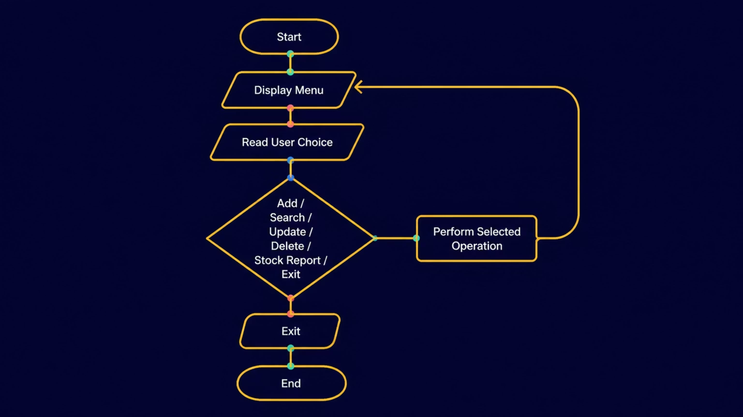
FLOWCHART
Main Program Flow
The flowchart illustrates the continuous menu loop. Each operation branches from a central decision diamond and returns control to the menu, except Exit which terminates the program.

Slide 7
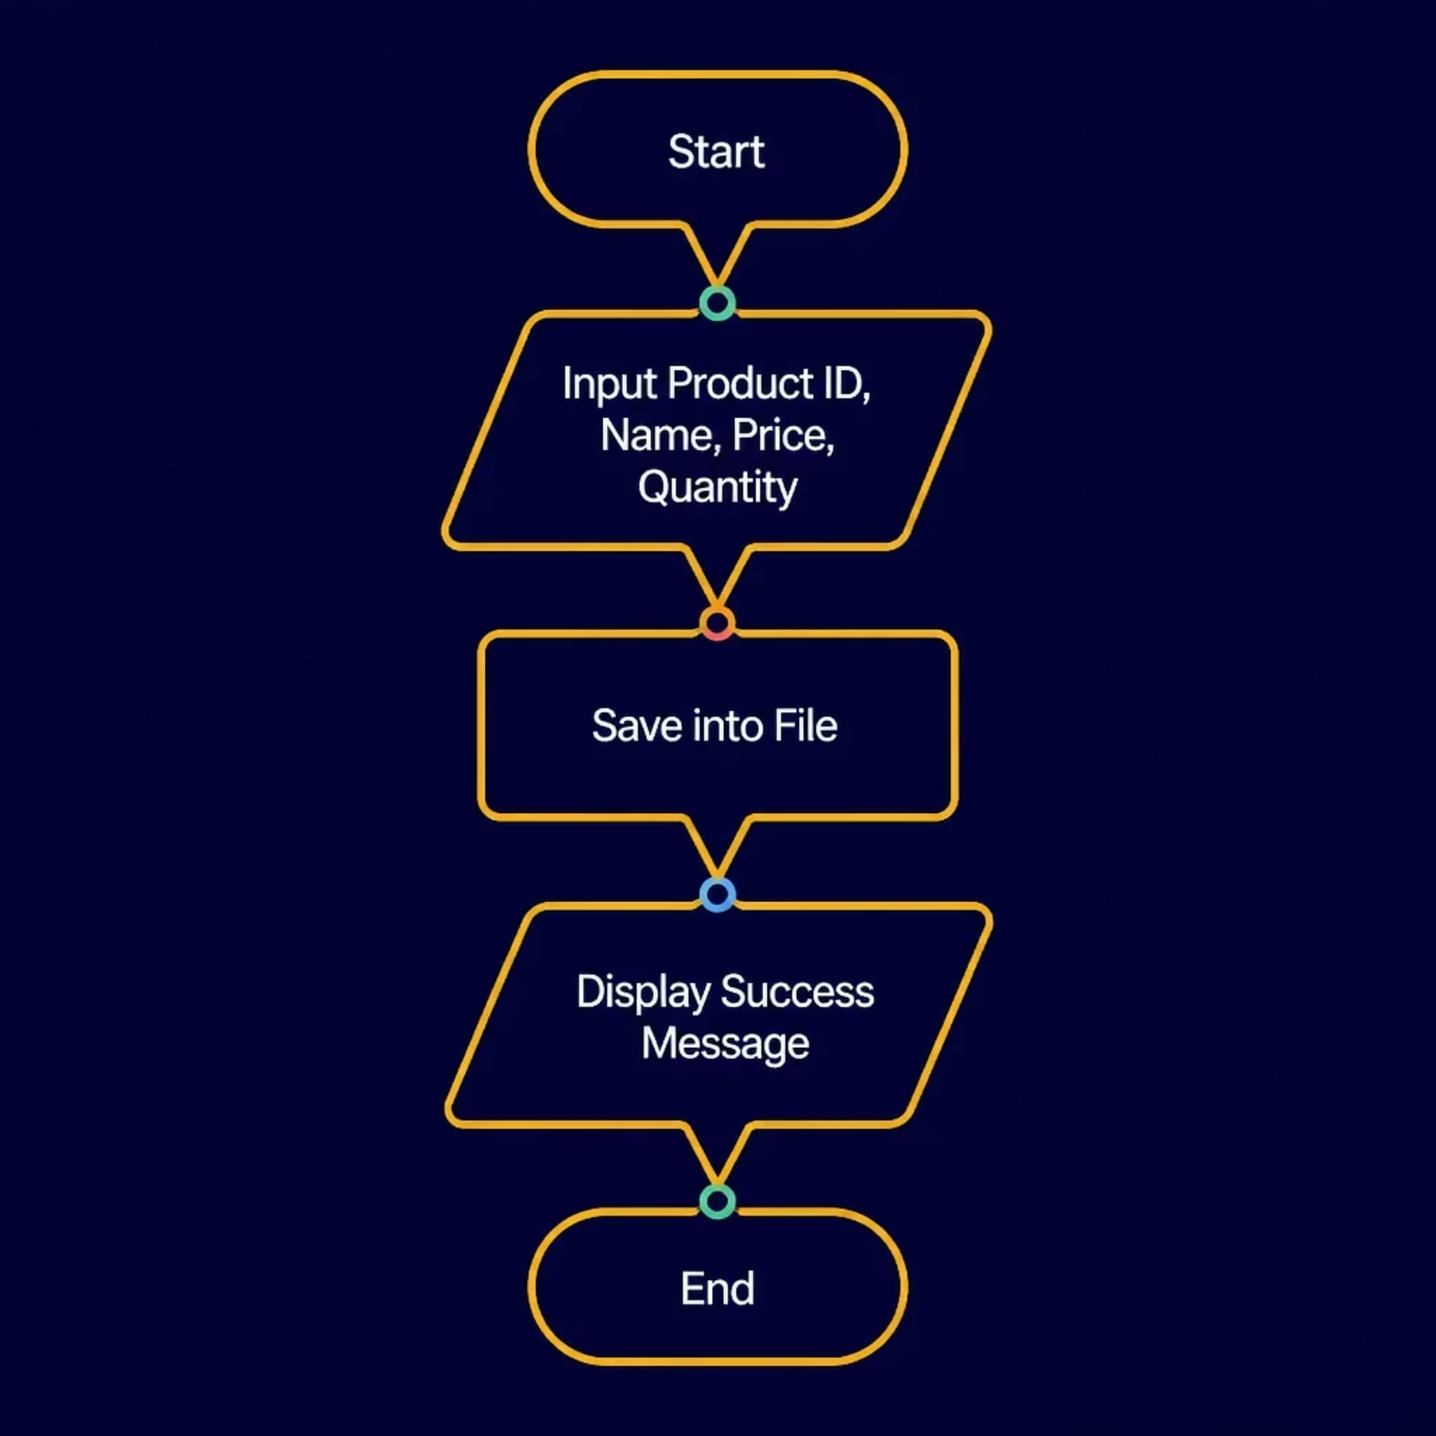
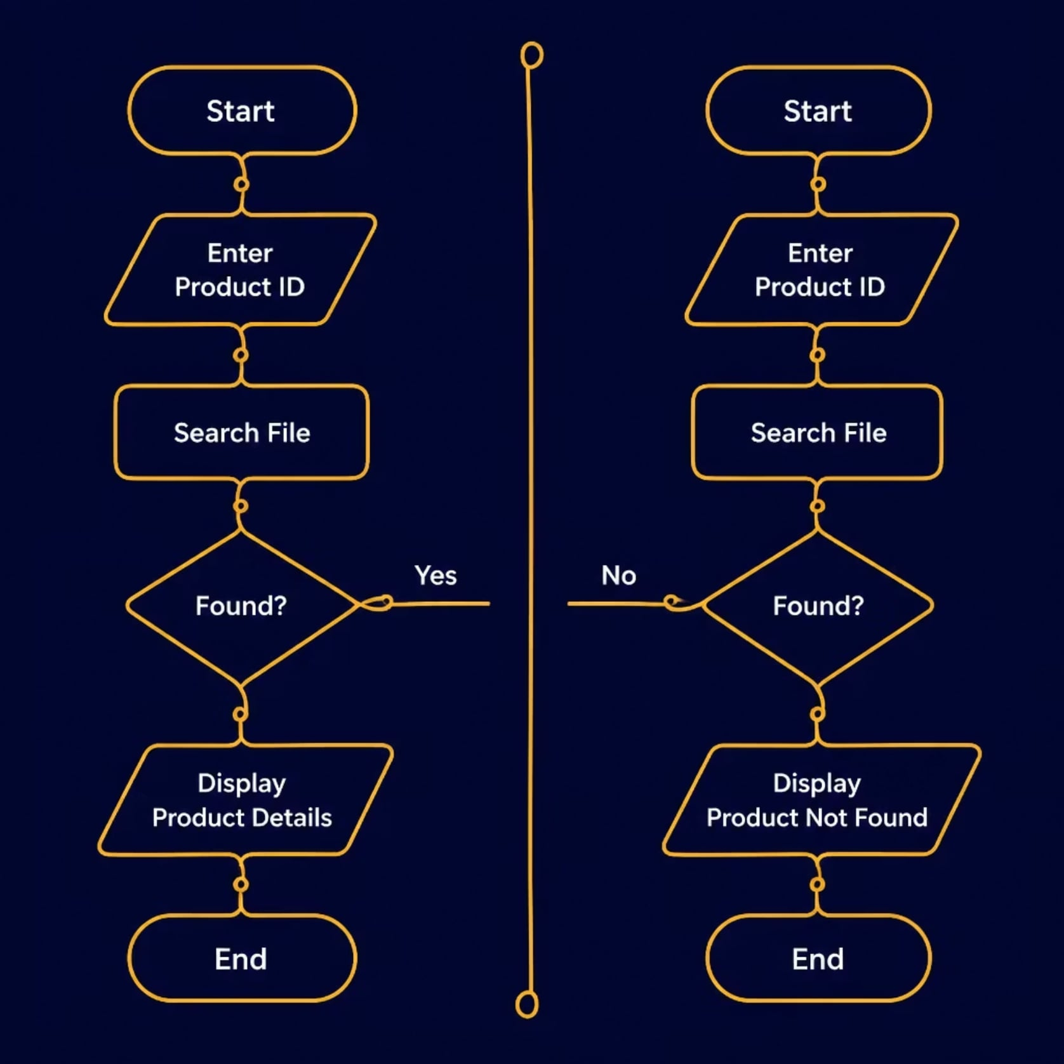
FLOWCHARTS
Add & Search Product Flowcharts
Add Product collects product details and writes them to file. Search Product reads the file and uses a decision branch to display either the product record or a "Not Found" message.

Slide 8
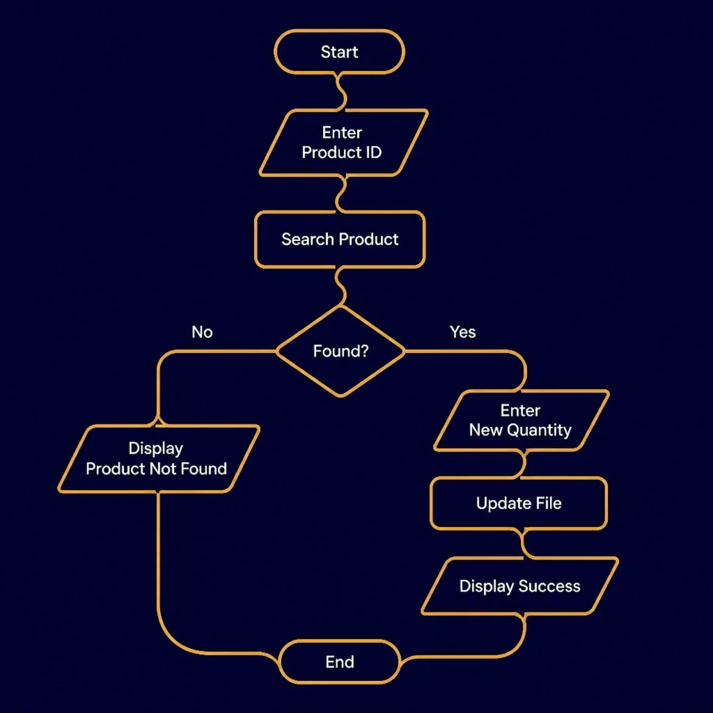
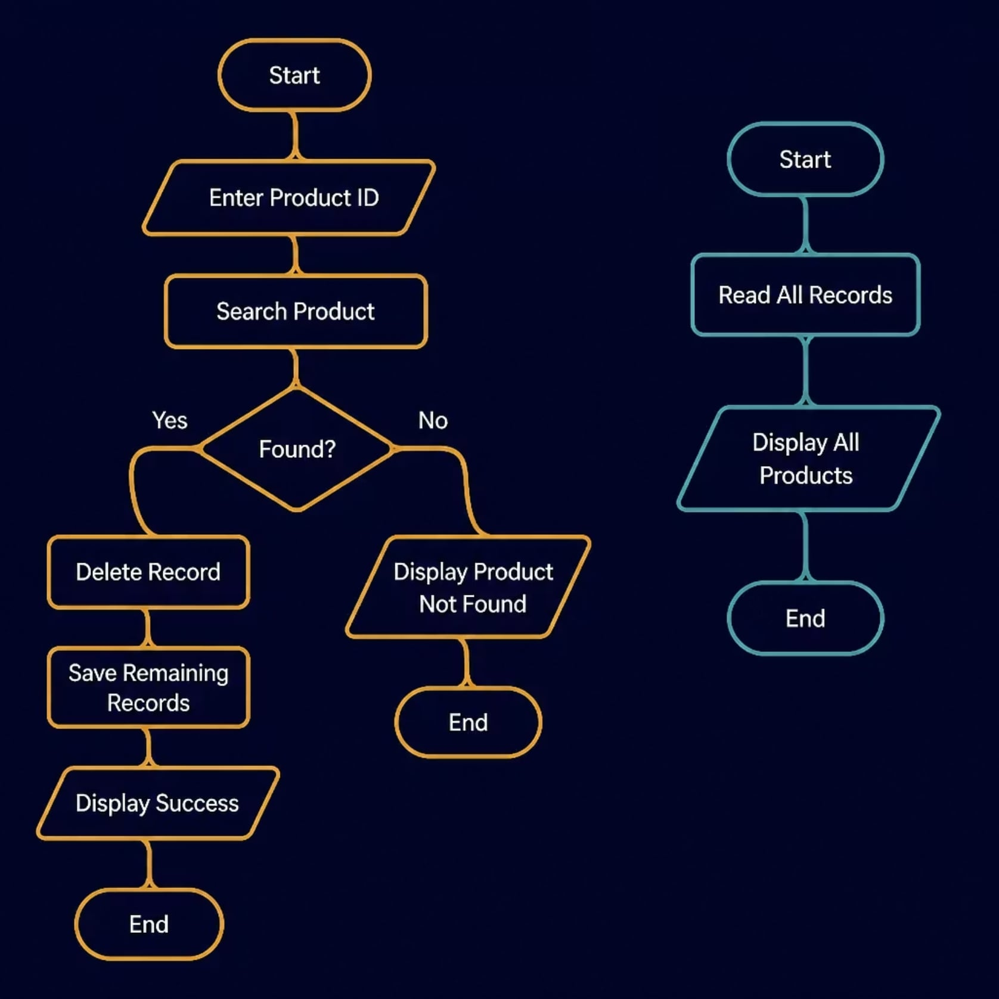
FLOWCHARTS
Update, Delete & Stock Report Flowcharts
Update and Delete both search for the product ID first, then proceed only if found. Stock Report simply reads and displays all records sequentially.

Slide 9
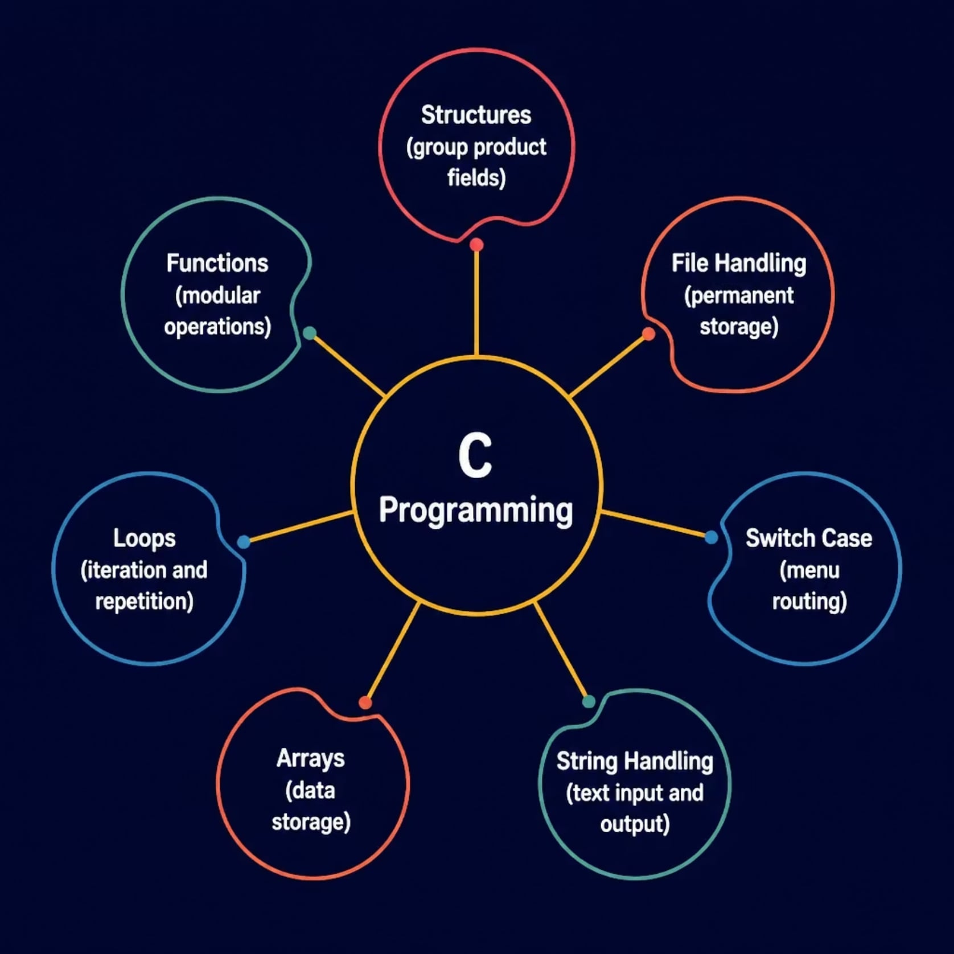
IMPLEMENTATION
C Programming Concepts Used
The system integrates core C concepts into a cohesive, modular application. Each concept plays a distinct role — from storing product data in structures to persisting records via file handling and routing user choices through a switch-case menu.
struct Product { int id; char name[50]; float price; int qty; };

Slide 10

SUMMARY
Conclusion
CRUD Operations
File Persistence
Full Create, Read, Update, Delete functionality for product records
Data retained across sessions using file handling in C
User-Friendly
Simple menu-driven interface, easy to navigate
This project demonstrates practical application of C programming to solve a real-world inventory management problem — efficiently and reliably.
Thank You

